Slide 1
Lesson Title: Introduction
Slide ID: 1
Programming/Interaction
Visual:
Image with start button and navigation button
On Screen Text
Writing Emergency Plans
Audio: Welcome to this course on how to create effective emergency plans! Before we begin, you have the option to click the navigation button on the left to learn how to navigate the course. If you’d like to jump right in, click the start button.
Feedback:

Slide 2
Lesson Title: Navigating the Course
Slide ID: 2
Programming/Interaction
Visual:
Arrows will fly in on top of the faded photo to show where each button is on the navigation
On Screen Text
N/A
Audio: Before we begin, here are some quick tips on how to navigate the course. You’ll want to click on play to play the audio or pause to pause the audio. To continue onto the next slide, click the next button. To go back a slide, click previous. Click the left-hand menu to go back to a specific section of the course. When you are ready, click next to continue.
Feedback:

Slide 3
Lesson Title: Learning Objectives
Slide ID: 3
Programming/Interaction
Visual:
Same faded image from navigation with each objective flying in on top of a light-colored shape
On Screen Text
(1)Describe the reasons emergency plans need to be in place
(2)Develop an effective emergency plan
(3)Identify and prioritize risks
Audio: By the end of this course, you will be able to (1) describe the reasons emergency plans need to be in place; (2) develop an effective emergency plan; and (3) identify and prioritize risks to be included in emergency plans. In order to meet these goals, you’ll be paired up with a fellow creator of emergency plans. Click Next when you’re ready to meet your partner.
Feedback:

Slide 4
Lesson Title: Avatar Introduction
Slide ID: 4
Programming/Interaction
Visual:
Bring in office and avatar (left) at start. At 1, fill in the blank for learner name appears on top left. At 2, fill in the blank for short response question appears on bottom left.
On Screen Text
N/A
Audio: Are you my partner? Thank goodness you’re here! I’m Andy. What’s your name? (1) Well, nice to meet you! I’ll admit, I’ve been having a hard time creating emergency plans on my own. What are some of the things you struggle with? (2) I’m finding it challenging to know what exactly to put in them and how to limit the possible emergency situations. Let’s figure this out together! Click next to continue.
Feedback:

Slide 5
Lesson Title: Reasons for Emergency Plans
Slide ID: 5
Programming/Interaction
Visual:
Users will click each icon image to reveal each of the five benefits to emergency plans; users will need to click through all of them.
On Screen Text
Back of flip cards say: conserving limited resources, limiting further damage or injury, limiting or avoiding negative media, limiting liability, and meeting regulatory requirements
%Name%, click each flip card to learn more.
Audio: Okay, so I know there are many different reasons to have an emergency plan, but I’m struggling to remember. Let’s flip each of these flashcards to review the reasons. Click next when you’ve reviewed all five.
Feedback:

Slide 6
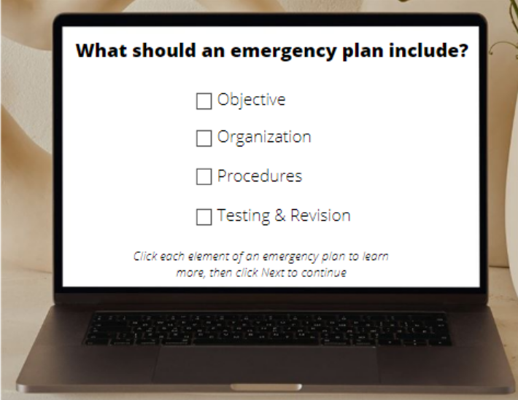
Lesson Title: Developing an Emergency Plan
Slide ID: 6
Programming/Interaction
Visual:
Laptop appears first followed by each section. User clicks a section which brings them to a description of what should be in the plan. Then user clicks a button to read Andy’s draft, types in their own suggestions, and compares to suggestions from the training. User clicks a button to go back to main screen and a checkmark appears. User does this for all four sections and cannot move forward until all are checked.
On Screen Text
%Name%,
Base – as seen
L1 – Objective: a brief summary of the purpose of the plan, who puts the plan into action, what the chain of command is in the event of an emergency
L2 – Organization: Appoint one individual as Emergency Coordinator and another as backup, clearly define duty responsibilities, authority and resources, seek assistance from external organizations, such as police or fire department
L3 – Procedures: include these elements: pre-emergency preparation, provisions for alerting and evacuating staff, specify safe locations for gathering
L4 – Testing & Revision: Conduct practices and drills regularly, when issues arise, revise the plan to address them, review at least annually
Audio: Let’s bring up my laptop and review what should be in an emergency plan. There are four main sections that we’ll want to make sure we put in the plan. After each section, maybe you can help me edit my drafts. I feel like they could use a second set of eyes.
Feedback:

Slide 7
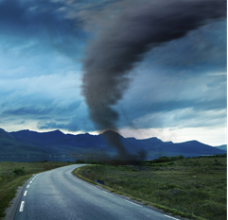
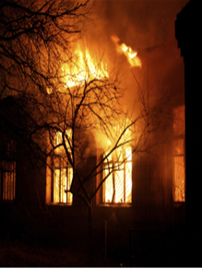
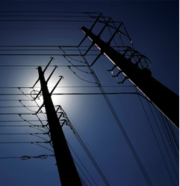
Lesson Title: Identify and Prioritize Risks – Common Scenarios
Slide ID: 7
Programming/Interaction
Visual:
Buttons line the top for the four most common scenarios. A blank box below the buttons fills in with the corresponding photo and information about the emergency. User cannot continue without clicking all four.
On Screen Text
Base – 4 buttons Fire, Natural Disasters, Technology Disasters, Criminal Incidents
L1 – Arson, fire hazards in apartments (e.g. newspapers stored next to furnaces), Electrical overload, resident inattention (e.g. stove fires), smoking and smoking materials, certain maintenance procedures (e.g. welding)
L2 – Floods, extreme winds, hurricanes, tornadoes, severe storms, earthquakes
L3 – Loss of utility services, power outage, life support systems that rely on technology, information systems or equipment, information theft
L4 – Burglary, robbery, assault, shootings, muggings, murder
Audio: This is great. Now we know how to write the plan. Let’s also take a look at some common emergency situations. Click each category to find out more about each and click next to continue.
Feedback:

Slide 8
Lesson Title: Identify and Prioritize Risks – Risk Matrix
Slide ID: 8
Programming/Interaction
Visual:
Bring in office and avatar at the beginning, followed by a light-colored box. Risk matrix will slowly appear on the white box in four quadrants. At 1, highlight the upper right and at 2, highlight the upper left.
On Screen Text
N/A
Audio: Hmm...it seems like there are a lot of possible emergency situations. I don’t think we can plan for everything. We could use a risk matrix to figure out what needs to be in our emergency plan. Our vertical axis will show how likely it is that an emergency will happen, and our horizontal axis will show what the impact would be if it were to happen. I’ve split this into four quadrants. The items we’ll want to urgently address will have a high likelihood and highly impact, (1) so anything in the upper right-hand corner, and we can probably leave out anything that has a low likelihood and a low impact, (2) so anything in the bottom left corner. Let’s practice plotting with a couple of scenarios.
Feedback:

Slide 9
Lesson Title: Identify and Prioritize Risks – Scenario 1
Slide ID: 9
Programming/Interaction
Visual:
Transition to a close up of the risk matrix with four common situation icons on the side. Learners will drag and drop icons into the quadrants and click submit. Feedback will appear on the right-hand side.
On Screen Text
N/A
Audio: So here’s the first scenario. I’m working on an emergency plan for a company in a town that has a high volume of hurricanes. It’s a small town with very little criminal activity. Where would you plot our four common emergency situations on the matrix? Drag and drop the icons into the risk matrix and click submit.
Feedback:

Slide 10
Lesson Title: Identify and Prioritize Risks – Scenario 2
Slide ID: 10
Programming/Interaction
Visual:
Risk matrix clears and four common situation icons reappear on the side. Learners will drag and drop icons into the quadrants and click submit. Feedback will appear on the right-hand side.
On Screen Text
N/A
Audio: Great job! Here’s my second scenario. This emergency plan is for a company in a busy city. There are severe implications for data breaches in their industry. Weather is usually pretty mild there, and while petty crime is high, chances are it wouldn’t cause a big disruption. Where would you plot our four common situations? Drag and Drop them onto the risk matrix and click submit.
Feedback:

Slide 11
Lesson Title: Quiz – Intro Slide
Slide ID: 11
Programming/Interaction
Visual:
Photo comes in first, with box and fly in instructions following
On Screen Text
There are 3 questions to help you make sure you understand emergency plans.
You will need to answer 80% of the questions correctly to pass.
Audio: None
Feedback:

Slide 12
Two of the following are examples of why it is important to write an emergency plan. Select the two correct responses and click submit.
Generate positive media
Meet regulatory requirements
Limit liability
Discover untapped resources
Feedback for correct: Correct! Meeting regulatory requirements and limiting liability are two examples of why it’s important to write emergency plans.
Feedback for incorrect: Oops! Meeting regulatory requirements and limiting liability are two examples of why it’s important to write emergency plans. They are also used to avoid negative media and conserve limited resources.
Lesson Title: Quiz Question 1
Slide ID: 12
Programming/Interaction
Visual:
Multiple select question with 2 correct responses (1 point for each correct response)
On Screen Text
See Visual
Audio: None
Feedback:

Slide 13
Sort the 4 sections of an emergency plan correctly and click submit. You will have 2 attempts.
Feedback on correct: Correct! The correct flow is objective, organization, procedures, and testing & revision.
Feedback on first incorrect: Oops! Let’s try again.
Feedback on second incorrect: Oops! The correct flow is objective, organization, procedures, and testing & revision.
Lesson Title: Quiz Question 2
Slide ID: 13
Programming/Interaction
Visual:
Sorting question, user has 2 attempts to sort correctly
1. Objective
2. Organization
3. Procedures
4. Testing & Revision
Procedures
Objective
Testing & Revision
Organization
On Screen Text
See Visual
Audio: None
Feedback:

Slide 14
Read the excerpt below. Select the section of the plan and click submit.
In the case of fire, smoke alarms will go off. Using the established evacuation procedures, employees should evacuate to the emergency meeting location. Evacuation Coordinator should take headcount and note any missing parties. Once authorities arrive, provide this information to them.
Objective
Organization
Procedures
Testing & Revision
Lesson Title: Quiz Question 3
Slide ID: 14
Programming/Interaction
Visual:
Single choice question
On Screen Text
See Visual
Audio: None
Feedback:

Slide 15
Lesson Title: Quiz Question 4
Slide ID: 15
Programming/Interaction
Visual:
Fill in the blanks for what each axis on a Risk Matrix stands for and click submit.
Fill in the blank, 2 points one point for each
Likelihood
On Screen Text
See Visual
Impact
Audio: None
Feedback:

Slide 16
Review this scenario: Company XYZ is creating an emergency plan. They must comply with data protection laws or face serious penalties, and the likelihood of a breach is increasing. They are also located in an area of the world where natural disasters are likely, but the damages tend to be minor. Based on this information, which situation more urgently requires an emergency plan?
Technology Situations
Natural Disasters
Feedback for Correct: That’s right! Technology Situations are high likelihood and high impact, so that plan should be developed first.
Feedback for Incorrect: Oops! While Natural Disasters have a high likelihood, they also have a minor impact. Technology Situations are high likelihood and high impact, so that plan should be developed first.
Lesson Title: Quiz Question 5
Slide ID: 16
Programming/Interaction
Visual:
Single response question
On Screen Text
N/A
Audio: None
Feedback:

Slide 17
Success Message: Congratulations! You’ve passed!
Failure Message: Try again! Click the Review button to go over your answers or click Retry to retake the quiz.
Lesson Title: Quiz Results
Slide ID: 17
Programming/Interaction
Visual:
Success: user will click next to move forward
Failure: user can click Review button to see response comparison and Retry button to retake the quiz
On Screen Text
See Visual
Audio: None
Feedback:

Slide 18
Lesson Title: Summary
Slide ID: 18
Programming/Interaction
Visual:
Office and avatar come onto the screen at the beginning, bring items 1, 2 and 3 in as laid out in audio as speech bubbles next to the avatar.
On Screen Text
Conserve limited resources, limit further damage or injury, limit or avoid negative media, limit liability, and meet regulatory requirements
There are four main parts of an emergency plan: Objective, Organization, Procedures, and Testing & Revision
Risks should be identified and prioritized to make sure you’re addressing the most urgent risks first
Audio: Thank you so much. I’ve learned a lot with your help. I now know that (1) emergency plans are needed because they help conserve limited resources, limit further damage or injury, limit or avoid negative media, limit liability, and meet regulatory requirements, (2) that there are four main parts of an emergency plan: Objective, Organization, Procedures, and Testing & Revision, and (3) that risks should be identified and prioritized to make sure you’re addressing the most urgent risks first. Good luck with your emergency plans!
Feedback:

Slide 19
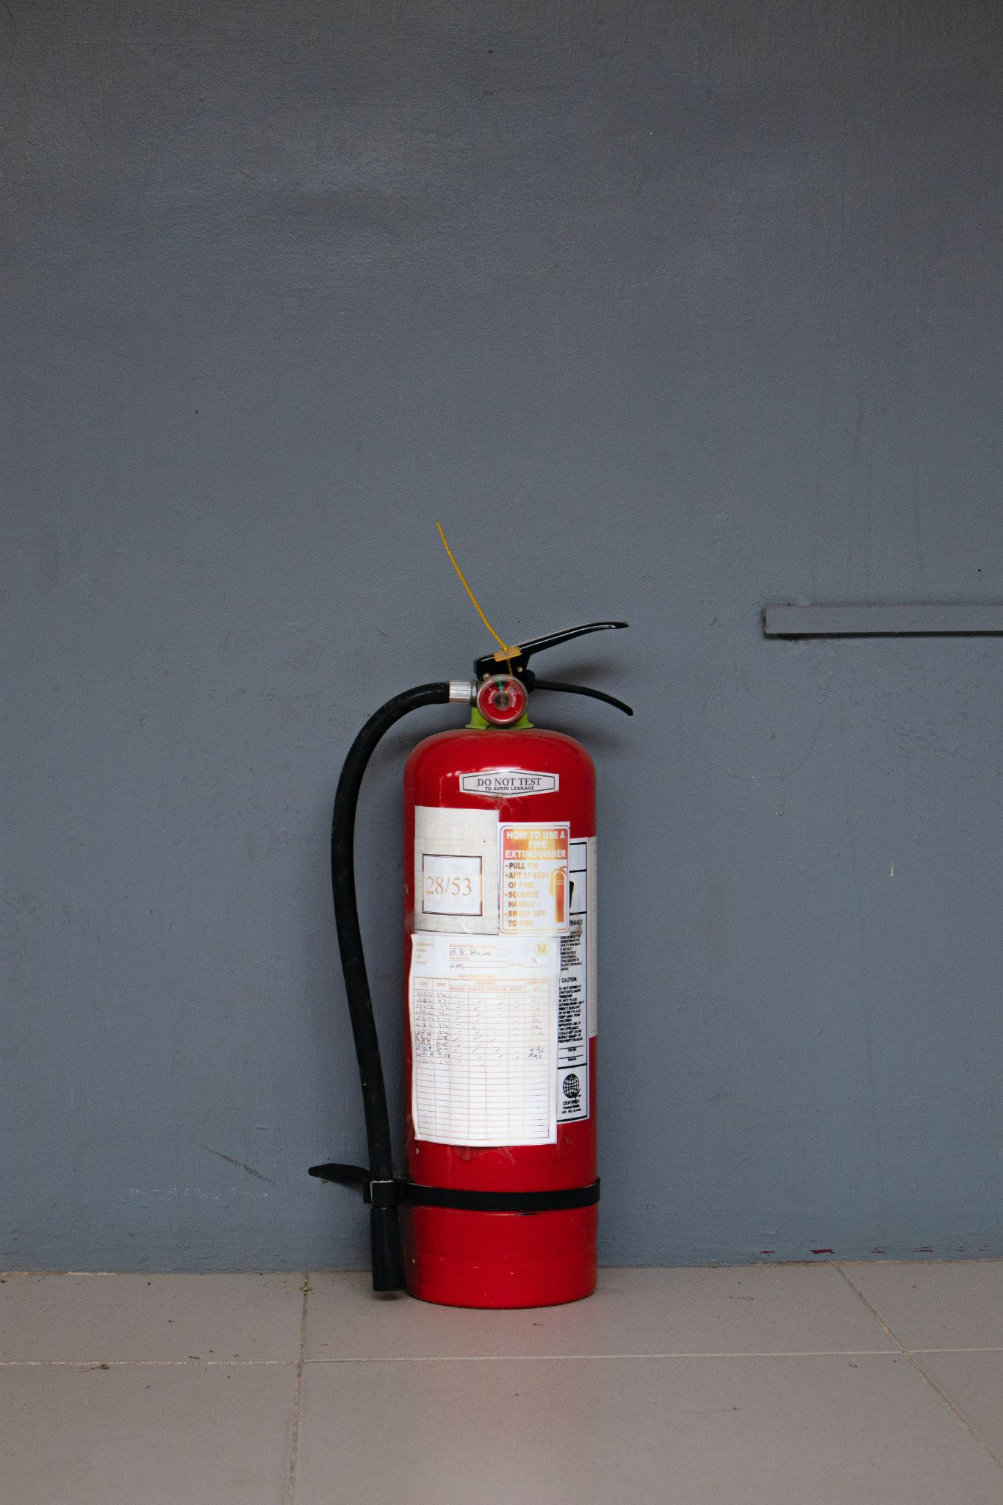
Congratulations! You’ve successfully
completed the module!
You may now close the course to exit.
Lesson Title: Conclusion
Slide ID: 19
Programming/Interaction
Visual:
N/A
On Screen Text
See Visual
Audio: None
Feedback:

